Slide 1
Offense vs. Defense: An Analysis of Winning in Major League Baseball
Adrian Montez
MLB Teams, 2015-2024

Slide 2

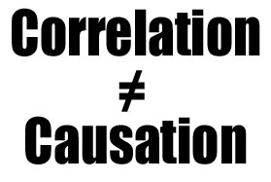
Project analysis slide 3
Motivation &
Research Question
Motivation
Teams deal with limited resources and many trade-off decisions
  Ex. Signing a talented pitcher could mean losing out on getting a valuable offensive player
Modern analytics provide standardized metrics for both dimensions
This analysis aims to provide insight on how to efficiently evaluate players
Research Question
Which dimension (offense or pitching) is more strongly associated with team winning percentage?
  Note: Analysis focuses on association, not causation

Slide 3


Project analysis slide 3
Data Overview
Dataset
Unit of Analysis: Team-Season
Time Frame: 2015-2024 (excluding 2020)
Sample Size: 30 teams x 9 seasons = 270 individual points
Sources
Performance Metrics: FanGraphs, Sport Reference
Payroll Data: Spotrac
Data is publicly available, standardized, and widely used in baseball analytics

Slide 4

Project analysis slide 3
Key Variables
Outcome Variable
Winning Percentage (WPct)
  Derived from wins and losses
Offense
Weighted Runs Created Plus (wRC+)
  100 = league average
Pitching
Fielding Independent Pitching Minus (FIP-)
  Lower values indicate better pitching
Control
Log-transformed Team Payroll

Slide 5
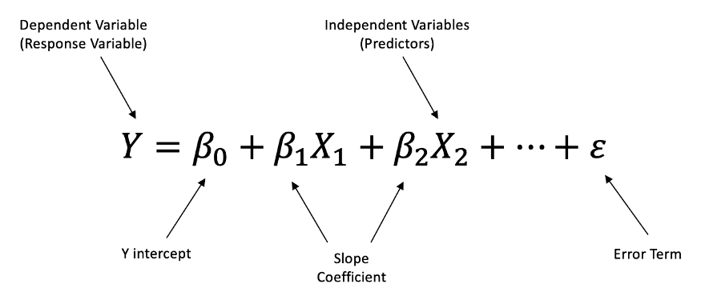
Project analysis slide 3
Analytical Approach
Method
Ordinary Least Squares (OLS) regression
Model Intuition
Estimate marginal associations between:
  Offensive performance and winning
  Pitching performance and winning
Controls
Payroll included to account for resource differences
Interpretation
Coefficients interpreted as conditional associations

Slide 6
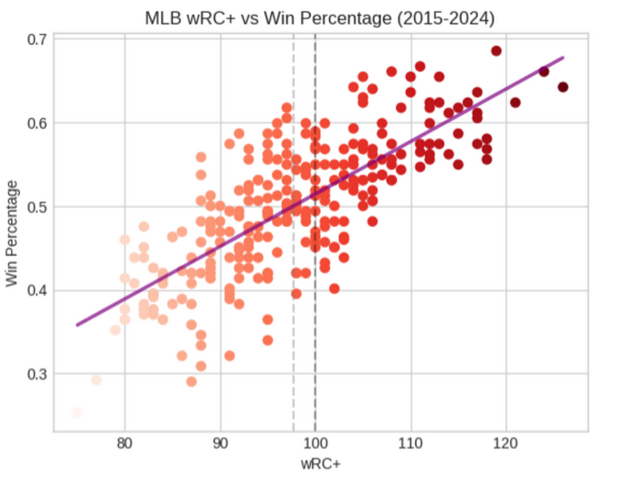
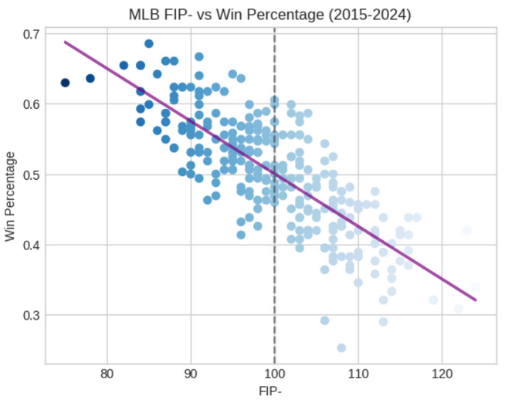
Project analysis slide 3
Descriptive Relationships
Observed Patterns
Higher wRC+ is associated with higher winning percentage
Lower FIP- is associated with higher winning percentage
Slightly stronger, tighter relationship between pitching and winning

Slide 7

Project analysis slide 3
Regression Results
Key Findings
Both offense (wRC+) and pitching (FIP-) are statistically significant predictors of winning percentage
Pitching shows a larger estimated marginal association than offense
Statistical Test
F-test rejects equality of coefficients
Interpretation
Pitching performance is more strongly associated with winning outcomes than offense

Slide 8

Project analysis slide 3
Robustness & Payroll
Alternative Metrics
OPS+ replaces wRC+
ERA- replaces FIP-
Results remain consistent
Payroll
Payroll not statistically significant once performance is included
Suggests payroll influences winning primarily through on-field performance

Slide 9
Project analysis slide 3
Limitations & Scope
Key Limitations
Observational data → no causal claims
Team-level aggregation masks within-team variation
Defensive performance not modeled
No team or year fixed effects included
Implication
Results should be interpreted as descriptive and comparative, not prescriptive

Slide 10
Project analysis slide 3
Decision Implications
& Takeaways
Decision Relevance
Pitching metrics may be comparatively more useful for:
  Performance diagnostics
  Comparative evaluation across teams
What this does not imply
Not a prescription for roster construction
Not a causal rule for spending decisions
Final Takeaway
Econometric tools can help clarify performance-outcome relationships in sports analysis

Slide 11
Thank You

Slide 12
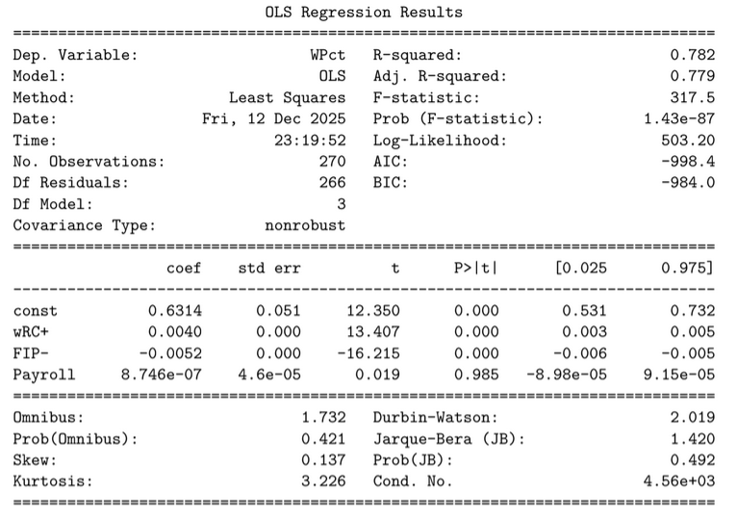
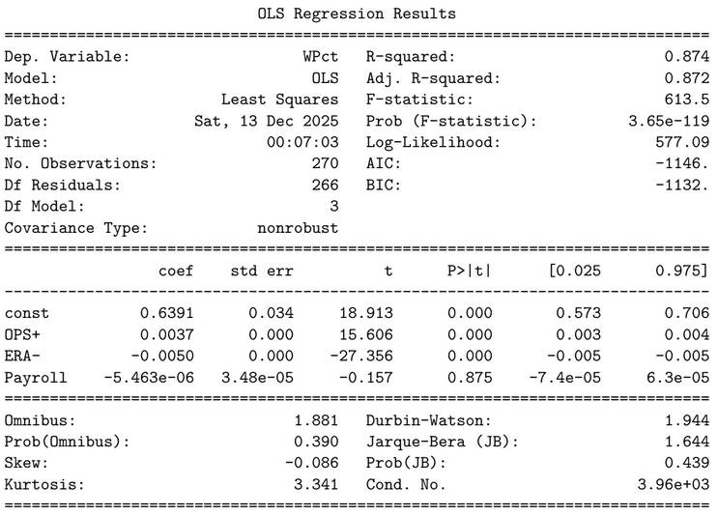
Project analysis slide 11
Appendix
Main Regression Results
Regression with Alternative Specifications

